Slide 1
Internal Block Diagram

Slide 2
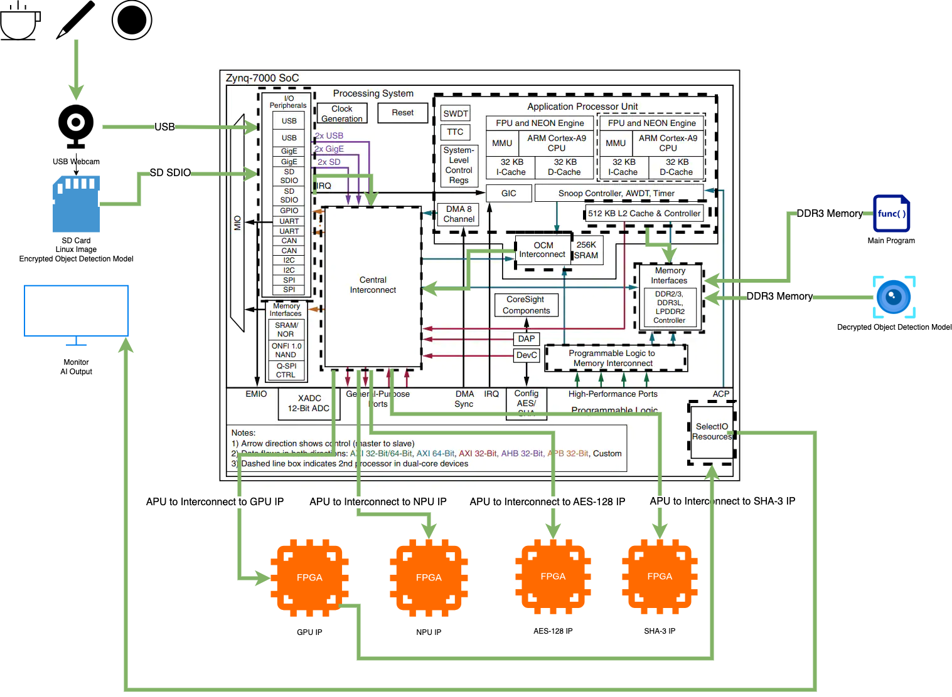

Slide 3
Requirements
(SYS_001) The system shall contain a RoT and performance processor.
(SYS_002) The RoT shall be an FPGA.
(SEC_011) The application software shall be encrypted using AES-128 Electronic Code Boot (ECB) (T)
(SYS_012) The system shall contain a screen that shows the processed image.
(SYS_019) Upon detection of a person, the system shall illuminate an LED (T), erase the object detection algorithm from the processor and put the system in reset (O).

Slide 4
Progress
AES-128 IP
GPU IP
Camera and Monitor I/O

Slide 5
Next Steps
NPU IP (Performance Processor)
SHA-3 IP
PUF
LED I/O
Voltage Sensor

